Slide 1

SMART INDIA HACKATHON 2026
TITLE PAGE
Problem Statement ID –26083
Problem Statement Title-Extreme Heatwave Early Warning and Human Thermal Stress Index
Theme-Disaster Management
PS Category- Software
Team ID-
Team Name- DataShield

Slide 2



From Temperature to Human Impact
DataShield
"AI-Powered Hyperlocal Heat Stress & Health Early Warning System’’
Problem Overview
Proposed Solution
Uniqueness & Novelty
• Standard heat warnings focus only on air temperature, which fails to show true health risks
• Real danger depends heavily on humidity, wind, radiation, exposure time, and local factors like building and tree density.
• For instance, two places at 40°C can cause entirely different body stress depending on conditions
• Elderly & outdoor workers face the highest exposure
• Question shifts: Answer not “how hot” but “how dangerous, here?”
• Predicts heat stress 3–5 days ahead using weather data, urban features, and standard heat indices (UTCI, WBGT).
• Forecasts ward-wise hospitalization and mortality risks based on demographics, housing, and health data.
• Ward-level mortality & hospitalization risk prediction
• GIS dashboard with color-coded ward-level alerts & advisories
• Recommends optimal locations for cooling primary health and ambulance centre to cover maximum wards.
• Send coming heatwave alert to citizen
Prescriptive, not predictive: optimized cooling-center/ambulance placement
Data-driven governance: Shifts from forecasting to work-shift simulation.
Refined 'temperature feel’: Additionally use vegetation or tree density (NDVI) and concrete or building density (built-up%) to measure the ‘temperature feel’.
Corrected air temp: Uses SUHI-to-air scaling (unlike standard models).
Comprehensive risk model: Dual mortality + hospitalization tracking with transparent proxies.
Ward-level insights: Infers outdoor-worker density via OpenStreetMap where census data lacks.
Self-calibrating thresholds: Mortality/hospitalization cutoffs come from the city's own historical summer data, not another city's climate.
Measured, not guessed, impact: Work-shift benefits are counted from real hourly UTCI data, not assumed percentages.
Beyond weather apps: Even Google/AccuWeather/IMD’s weather app’s area-to-area differences are a rough guess-correction on one coarse grid model — not real local vegetation/concrete data. We train per-ward on actual satellite data, turning it into health risk + action.

Slide 3
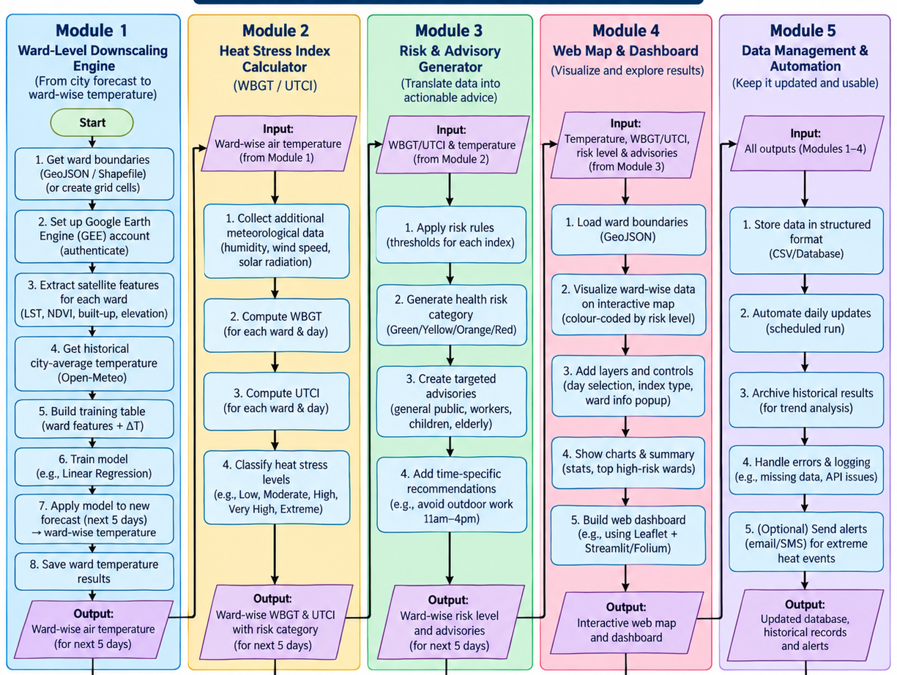
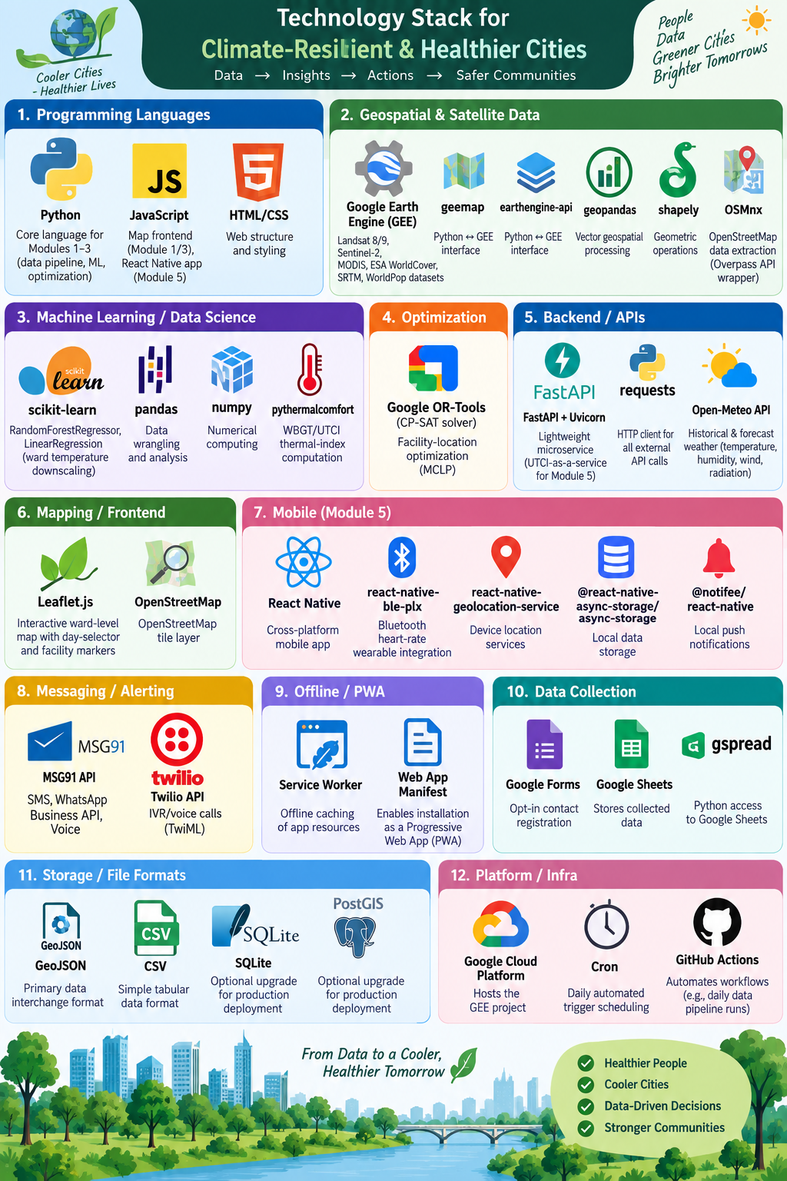
TECHNICAL APPROACH
DataShield
Low-level Flow Chart:
Tools to be used:

Slide 4



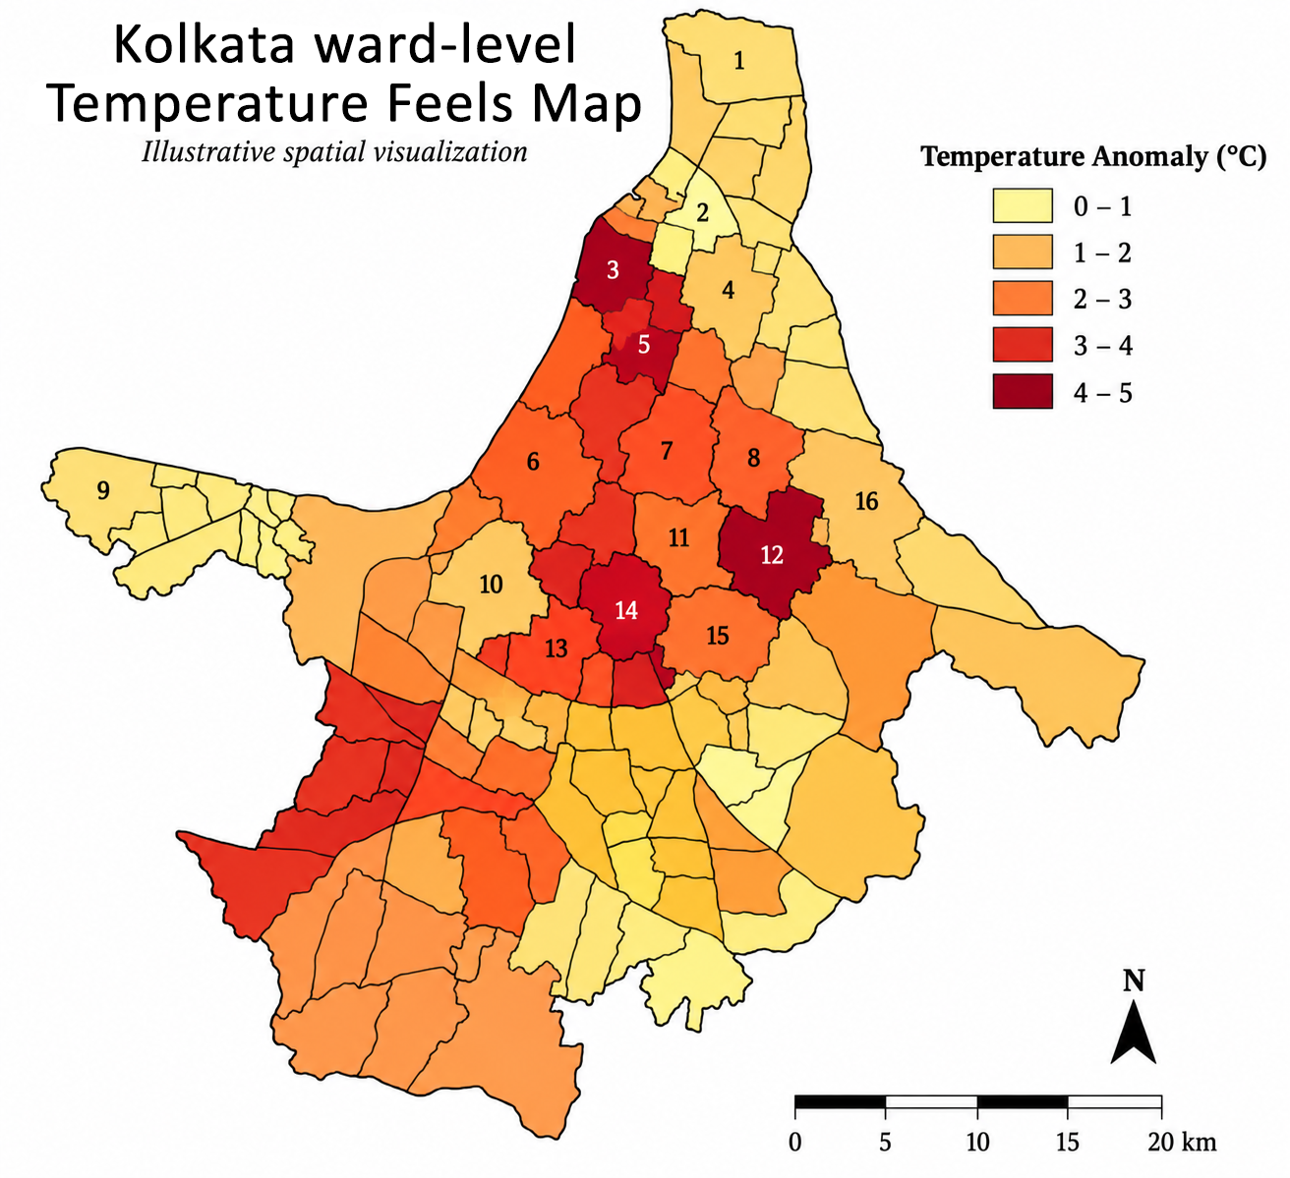












FEASIBILITY AND VIABILITY
DataShield
Potential Challenges & Risks
Feasibility of the Idea
Data & Prediction Uncertainty
Weather/satellite gaps and AI model errors can affect ward-level accuracy.
Proven, Ready APIs
Open-Meteo, IMD, GEE & WhatsApp/SMS APIs plug in directly — no need to build from scratch.
Tech & Language Barriers
Patchy internet, low smartphone access, local dialects & code-mixing limit reach.
Human-Centered Indices
UTCI & WBGT capture true physiological heat stress, not just air temperature.
Privacy & Govt. Integration
Consent, secure data handling, API changes & coordination delays complicate rollout.
Rich Public Data
Combines weather, satellite, population & vulnerability datasets.
Strategies to Overcome Them
Lean & Scalable
Open-source software & standard cloud infra; GPU optional — the same pipeline expands to new cities.
Continuous AI Validation
Explainable models, confidence thresholds, human-in-the-loop review & fallback alerts boost reliability.
Mass-Reach Channels
SMS/WhatsApp alerts plus a citizen dashboard for wide accessibility.
Built for Low Connectivity
Offline/SMS support, compressed alerts, multilingual NLP & gradual local calibration close the gap.
Inclusive by Design
Local-language alerts & simple, actionable guidance for citizens, hospitals and authorities.
Privacy-First Integration
Data minimization, encryption, role-based access & cached government data ensure a secure rollout.

Slide 5












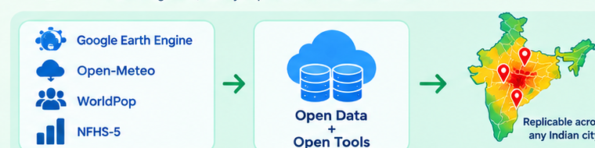
IMPACT AND BENEFITS
DataShield
Potential impact on the target audience
Benefits of the solution
Citizens
Hyperlocal precision over blanket warnings
Receive hyperlocal heat-risk alerts in advance with personalized safety guidance.
Replaces city-wide forecasts with ward-by-ward risk maps so dense wards get flagged even when the official forecast looks moderate.
Local Communities
Lives-based prioritization, not just heat maps
Access timely information in local languages for better awareness and preparedness.
Folds in elderly population, housing vulnerability & health-insurance access to show which wards need help most.
Hospitals
Physiologically accurate risk
Get early alerts to prepare for a possible increase in heat-related patients.
Uses UTCI/WBGT (humidity, wind, radiation) instead of raw °C — critical where 'feels like' differs sharply.
Healthcare Teams
Quantified, defensible impact estimates
Improve resource and staff planning based on predicted heat-related health risks.
Outputs expected excess deaths per ward using peer-reviewed dose-response relationships for concrete planning.
Authorities
Built on free, open & scalable infrastructure
Gain ward-level risk visibility for data-driven heat-action planning and timely interventions.
Google Earth Engine, Open-Meteo, WorldPop & NFHS-5 — zero licensing cost, easily replicated across Indian cities.

Slide 6

RESEARCH AND REFERENCES
DataShield
Research
Evidence behind a ward-level heat & health early-warning system
Here is what the wider research says about closing that gap.
Heat Already Kills, and at Scale
Risk Isn't Equal for Everyone
Measuring Heat in the Right Way
In May 2010, Ahmedabad experienced a devastating heatwave with temperatures peaking at 46.8ºC, resulting in 1,344 excess deaths during that single month. [1]
After India's first Ahmedabad Heat Action Plan was implemented in 2013, mortality rates on the hottest days (at or above 45°C) dropped by approximately 27%. [2]
A study analysing 30 years of mortality data in Ahmedabad, from 1987 to 2017, showed: above 28°C, daily mortality increases by about 9.56% for every 1°C rise in temperature. [3]
Data analysis reveals that heat stress and extreme temperature areas in India have expanded by 20% to 40% per decade across central and northwest regions. [4]
The RAND Corporation’s first country-wide, district-level Heat Wave Vulnerability Mapping for India was published in 2017, identify regions in Madhya Pradesh and Chhattisgarh, as having the highest overall heat vulnerability due to low urbanization and poorer socioeconomic infrastructure. [5]
Sensor-based observational research in West Bengal's informal settlements indicates that elderly slum residents routinely cross critical indoor heat danger thresholds daily. Elderly women experiencing a significantly higher prevalence of severe heat symptoms and fewer coping resources compared to men. [6]
An analytical four-city study across India, including Kolkata, indicates that slum populations experience consistently higher vulnerability and severe multi-dimensional deprivations compared to non-slum areas. [7][8]
Standard Celsius (°C) temperature readings do not accurately reflect human heat stress because they measure ambient air temperature while ignoring critical environmental variables like humidity, wind speed, and solar radiation; So we must rely on more comprehensive thermal indices like the Wet-Bulb Globe Temperature (WBGT) and the Universal Thermal Climate Index (UTCI).. [9]
The UTCI is highly sensitive to radiation fluxes. In Northwest India, intense solar radiation and lack of cloud cover create exceptionally high Mean Radiant Temperature. [4]
The Universal Thermal Climate Index (UTCI) uses specific temperature bands to classify how the human body experiences thermal stress [10]
IMD's heatwave alerts still use one temperature threshold per city. [11]
References
[1] https://pmc.ncbi.nlm.nih.gov/articles/PMC3954798/
[2] https://www.preventionweb.net/news/india-new-evidence-shows-pioneering-heat-action-plan-helps-millions-avoid-killer-heat
[3] https://www.sciencedirect.com/science/article/abs/pii/S0013935121005260
[4] https://india.mongabay.com/2025/12/heat-stress-is-intensifying-across-indian-states-shows-data-analysis/
[5] https://www.mdpi.com/1660-4601/14/4/357
[6] https://www.mdpi.com/2075-5309/15/13/2274
[7] https://www.downtoearth.org.in/urbanisation/covid-19-4-factors-to-test-how-vulnerable-slums-in-4-big-cities-are-71833
[8] https://www.ncbi.nlm.nih.gov/pmc/articles/PMC8750942/
[9] https://pmc.ncbi.nlm.nih.gov/articles/PMC9206009/
[10] https://climate-adapt.eea.europa.eu/en/metadata/indicators/thermal-comfort-indices-universal-thermal-climate-index-1979-2019
[11] https://anantamias.com/heat-wave-india/
@SIH Idea submission- Template
6

